Slide 1
Accurately Providing a Place for Advice on Reddit
Michelle Ng

Slide 2
Problem Statement
We spend most of our time on the internet, and yet we are getting more lonely
More and more people are seeking advice on message boards
We want to provide a classifier that is able to accurately classify whether a post might be more suited for r/JUSTNOMIL or r/relationships
This is important as some of the advice is needed urgently
It is important to ask people who know best for advice

Slide 3
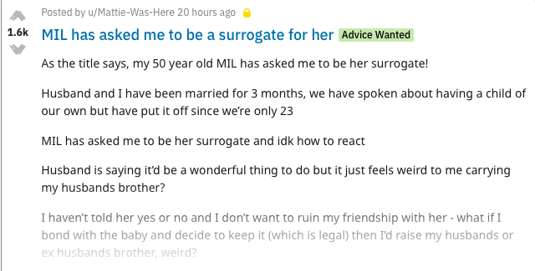
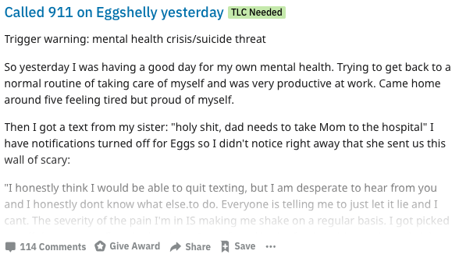

Slide 4
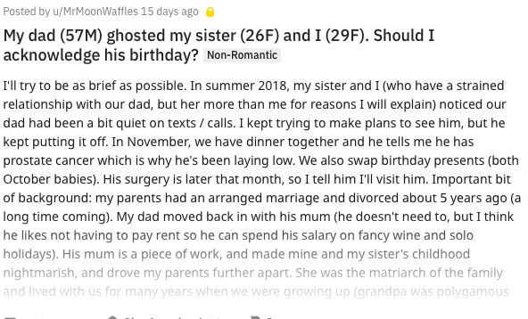
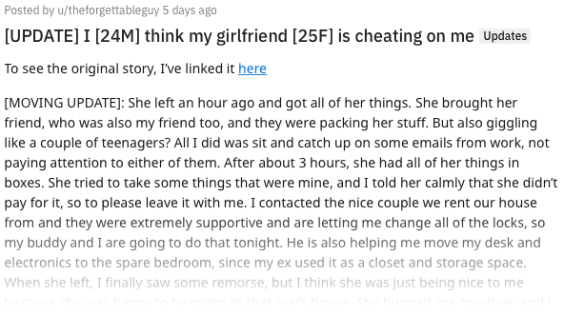

Slide 5
Data Gathering and Cleaning
Beautiful Soup to scrape the recent 1000 posts on r/JUSTNOMIL and r/relationships
Posts exported out into CSV

Slide 6
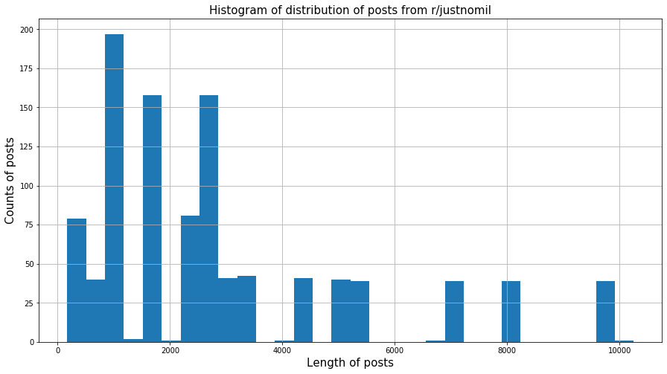
Data Exploration

Slide 7
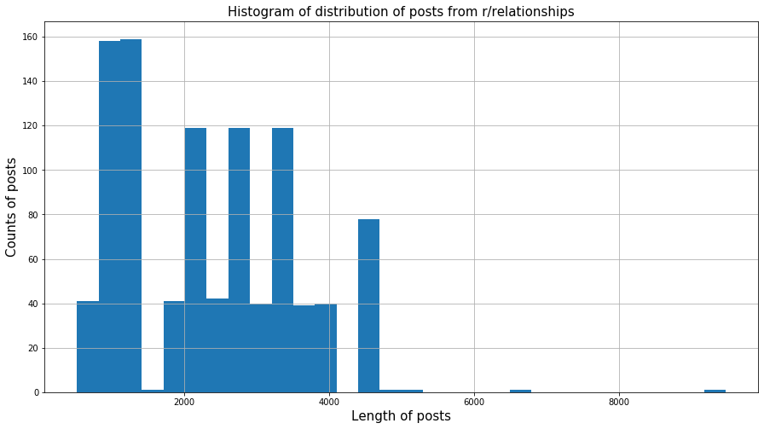
Data Exploration

Slide 8
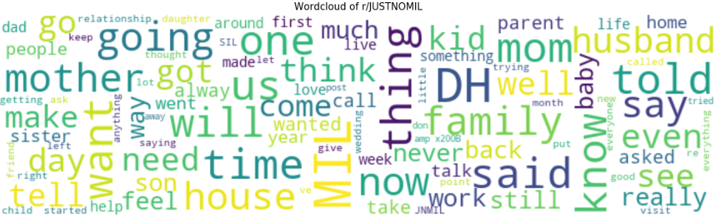
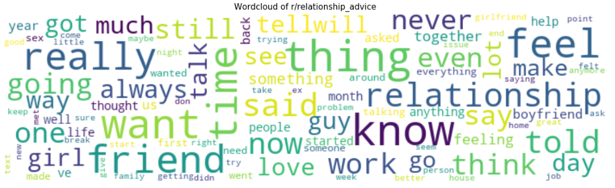
Data Cleaning

Slide 9
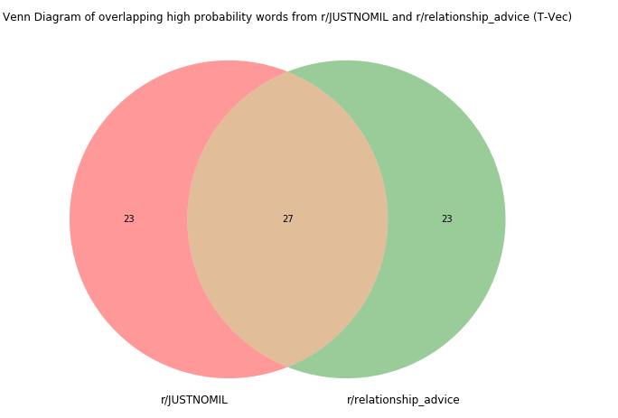
23
23
'dh’ 'mom’
'family’ 'mother’
'husband’ 'baby’
'house’ 'kid’
'son’ 'child’
'see’ 'sil’ 'need’
'well’ 'come’
'wedding’
'week’ 'tell’
'daughter’
'could’ 'home’
'call’ 'parent'
27
'friend’ ‘girl’
‘love’ ‘together’
'month’ ‘guy’
‘boyfriend’ ‘sex’
‘work’ ‘still’ ‘feel’
‘like’ ‘feeling’
‘always’ ‘started’
‘talk’ ‘girlfriend’
‘way’ ‘since’
‘lot’ ‘help’
‘something’
‘dating’ ‘life'
'wa’ 'ha’ 'get’ 'time’
'like’ 'would’ 'want’
'know’ 'said’ 'told’
'going’ 'one’ 'year’
'go’ 'thing’ 'day’
'say’ 'even’ 'back’
'never’ ‘got’ 'make’
'think’ 'also’
'feel’ 'really’
'much'

Slide 10
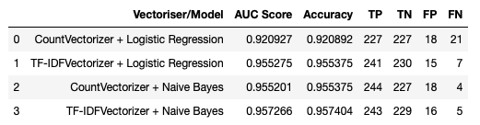
Result and Conclusion
Logistic Regression seems to be less accurate
Models with TF-IDF Vectorizer tend to have less wrong classifications
If it is possible, we can explore the following courses of action:
- introducing regularisation to the logistic regression model
- try decision trees instead
- develop tool further to decide on danger level of poster.

